Slide 1
P-NP Problems

Slide 2
Tractable Vs Intractable

Slide 3
Decision Problems
To keep things simple, we will mainly concern ourselves with decision problems. These problems only require a single bit output: “yes” and “no”.
How would you solve the following decision problems?
Is this directed graph acyclic?
Is there a spanning tree of this undirected graph with total weight less
than w?
Does this bipartite graph have a perfect (all nodes matched) matching?
Does the pattern P appear as a substring in text T?
All the decision problems mentioned above are in P.

Slide 4
P and NP
What is P?
P is the set of all decision problems which can be solved in polynomial time by a deterministic Turing machine. Since it can be solved in polynomial time, it can also be verified in polynomial time.
What is NP?
NP is the set of all decision problems (question with yes-or-no answer) for which the 'yes'-answers can be verified in polynomial time (O(n^{k}) where n is the problem size, and k is a constant) by a deterministic Turing machine.
Polynomial time is sometimes used as the definition of fast or quickly.
Only a non-deterministic computer solves the NP problem in a polynomial time. Therefore P is a subset of NP.

Slide 5
Non-Determinism

Slide 6
NP
The class NP (meaning Non-deterministic Polynomial time)
What makes these problems special is that they might be hard to solve, but a short answer can always be printed in the back, and it is easy to see that the answer is correct once you see it.
Example... Does the given graph have a Hamiltonian Path?
No guarantee if answer is “no”.
But given a path, can we verify if it is correct? “Yes”

Slide 7
P vs NP

Slide 8
Polynomial-Time Algorithms
Ex: while (true) continue

Slide 9
Tractability

Slide 10
NP-Complete Problems

Slide 11
NPC – Hamiltonian Cycles

Slide 12
P and NP

Slide 13
Is P = NP?

Slide 14
NP Complete Problems

Slide 15
Reduction

Slide 16
Reducibility

Slide 17
Using Reductions

Slide 18
NP-Hard and NP-Complete

Slide 19
NP Complete Problems

Slide 20
Why Prove NP-Completeness?

Slide 21
Proving NP-Completeness

Slide 22
NP-Complete – Example: Clique Problem

Slide 23
Example: Satisfiability Problem (SAT)

Slide 24
Few other examples…

Slide 25
Few other examples…

Slide 26
Classes of P and NP

Slide 27
Relationship between P and NP

Slide 28
How to prove problem is NP-Complete?

Slide 29
NP-Complete
What is NP-Complete?
A problem x that is in NP is also in NP-Complete if and only if every other problem in NP can be quickly (ie. in polynomial time) transformed into x. In other words:
x is in NP, and
Every problem in NP is reducible to x
So what makes NP-Complete so interesting is that if any one of the NP-Complete problems was to be solved quickly then all NP problems can be solved quickly
“NP-Complete” comes from:
Nondeterministic Polynomial
Complete - “Solve one, Solve them all”

Slide 30
NP-Hard
What is NP-Hard?
NP-Hard are problems that are at least as hard as the hardest problems in NP.
A problem is NP hard if every problem in NP can be polynomially reduced to it
Note that NP-Complete problems are also NP-hard.
However not all NP-hard problems are NP (or even a decision problem), despite having 'NP' as a prefix. That is the NP in NP-hard does not mean 'non-deterministic polynomial time’.
All optimization problems in NP are NP-Hard and all decision problems in NP are NP-Complete

Slide 31
co-NP
What is co-NP?
A decision problem X is a member of co-NP if and only if its complement X is in the complexity class NP.
In simple terms, co-NP is the class of problems for which there is a polynomial-time algorithm that can verify "no" instances (sometimes called counterexamples) given the appropriate certificate.
Equivalently, co-NP is the set of decision problems where the "no" instances can be accepted in polynomial time by a non-deterministic Turing machine.

Slide 32
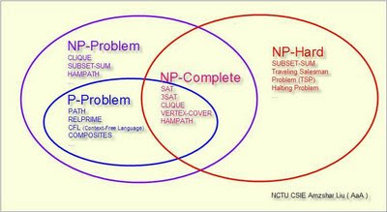
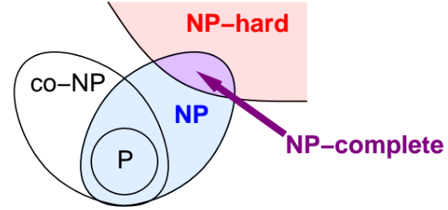
Relationship between NP-Complete and NP-Hard

